Slide 1
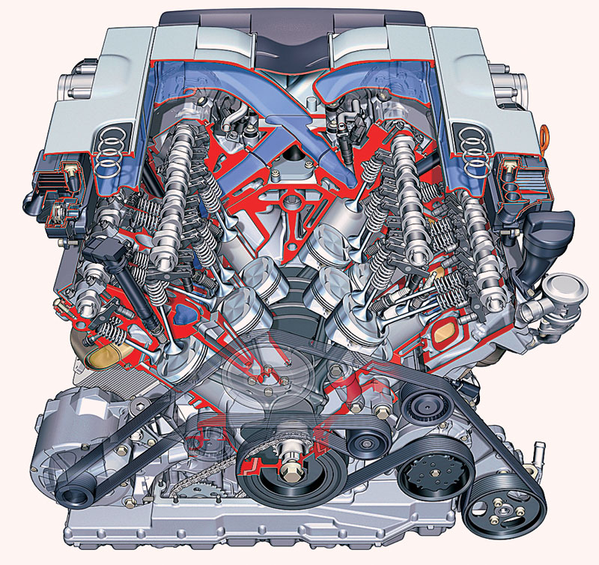
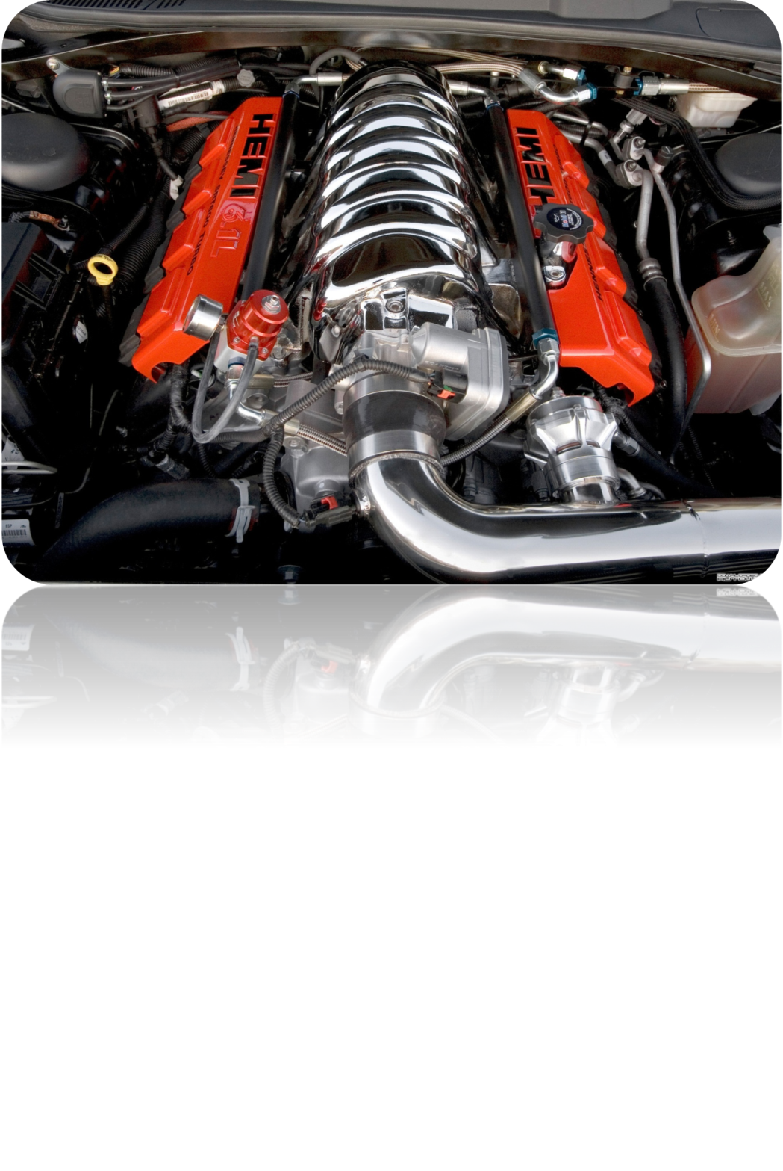
Topic: Internal combastion
engine

Slide 2
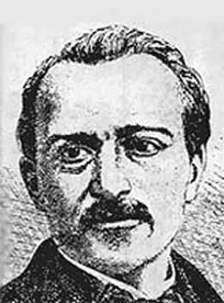
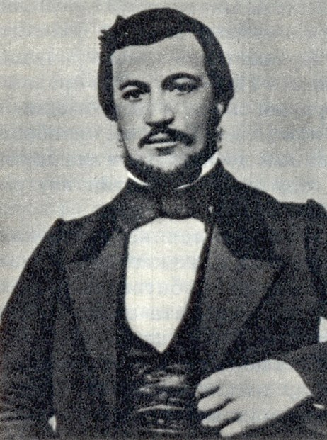
HISTORY OF ENGINE DESIGN
The first successful internal combustion engine was designed by Etienne Leonoire in 1860.
The used fuel was illuminating gas. Liquid fuels such as petrol, paraffin, alcohol, oil may be used. But they must be vaporised by a carburetor.
In 1878 Dr. Otto of Cologne
invented a four stroke engine,
which today is commonly used
as a car engine.

Slide 3
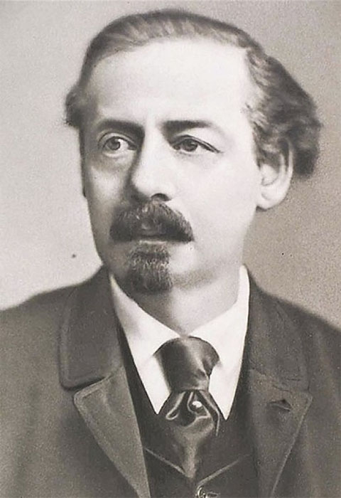
The world's first car with a gasoline engine was designed by the Austrian inventor Siegfried Marcus.

Slide 4
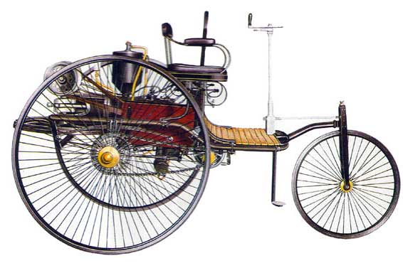
Siegfried`s first vehicle.

Slide 5
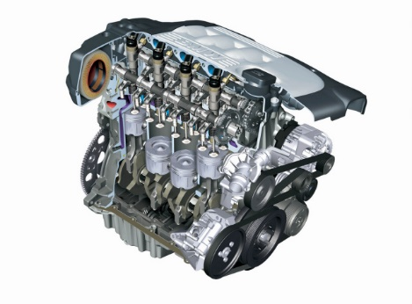
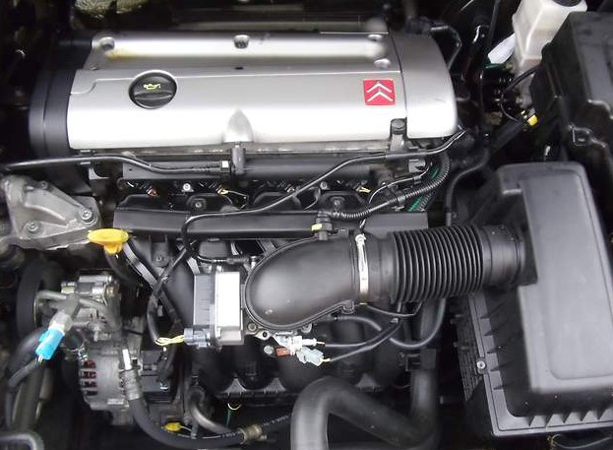
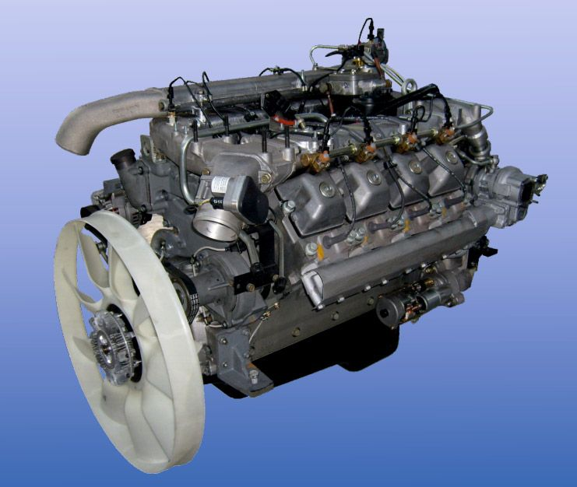
Engines can be divided into three main types: a gasoline, a diesel and a gas engine

Slide 6
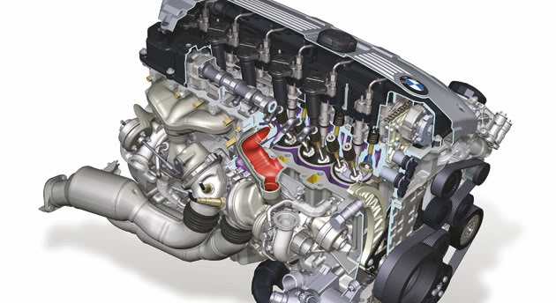
Inline engine

Slide 7
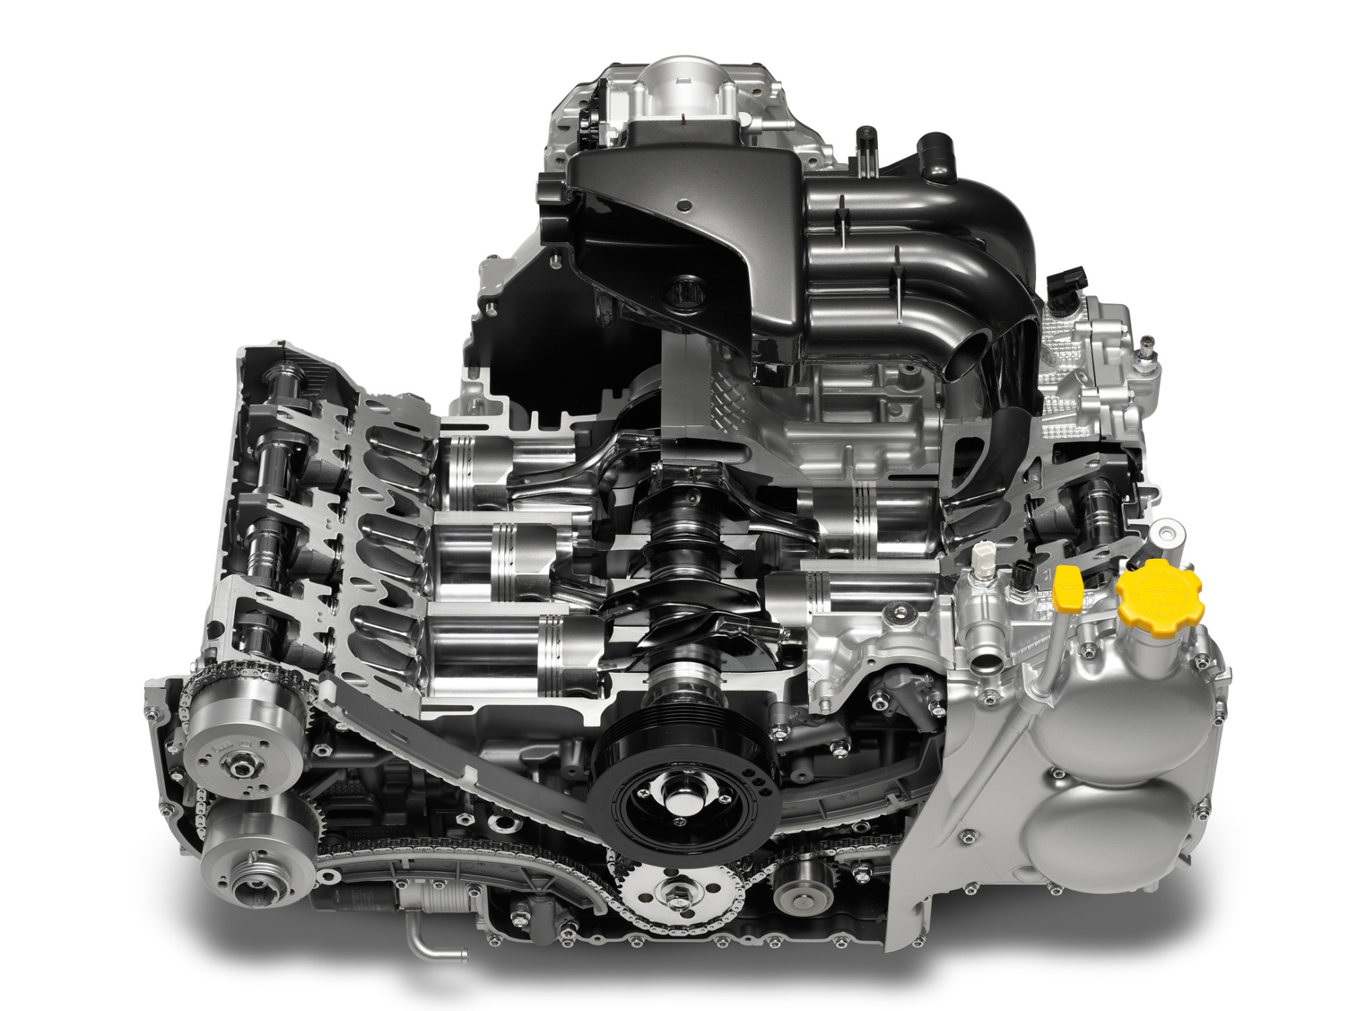
Opposed engine

Slide 8
W-shaped engine

Slide 9
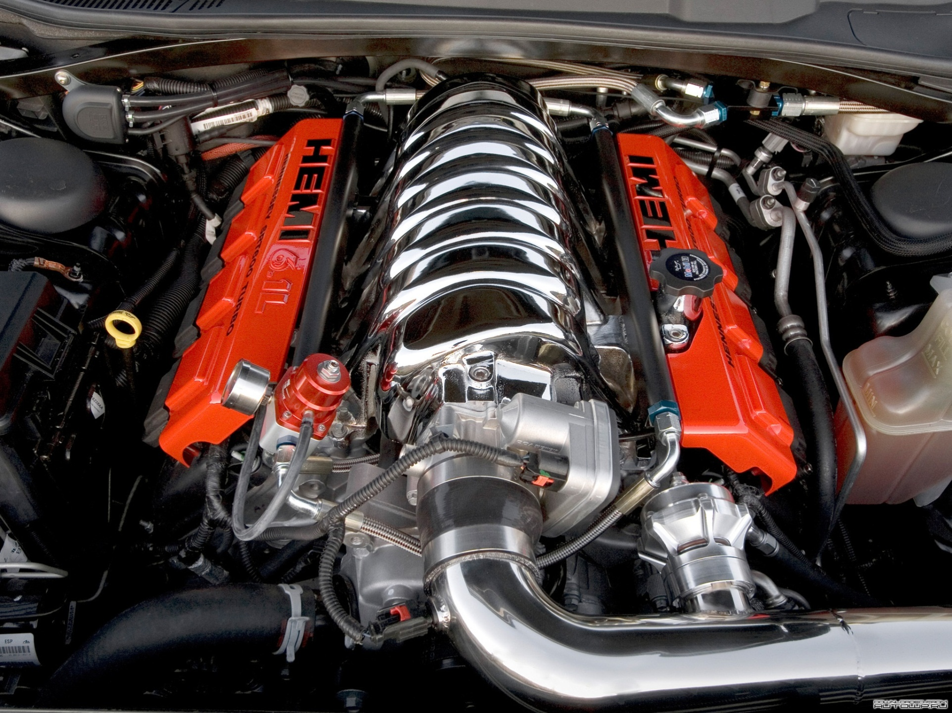
V-shaped engine

Slide 10
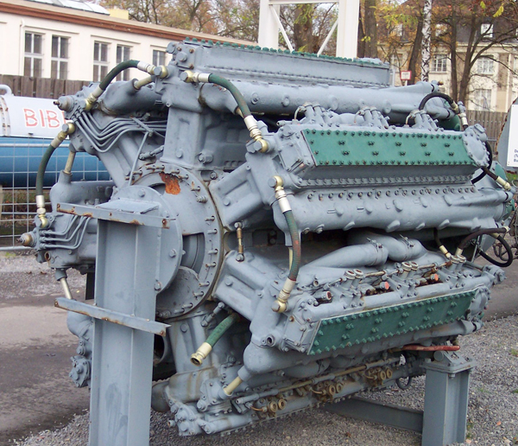
Radial engine

Slide 11
So, modern engines contain
cylinders ranging
from two to twenty- four cylinders.
There are different types of engines:

Slide 12
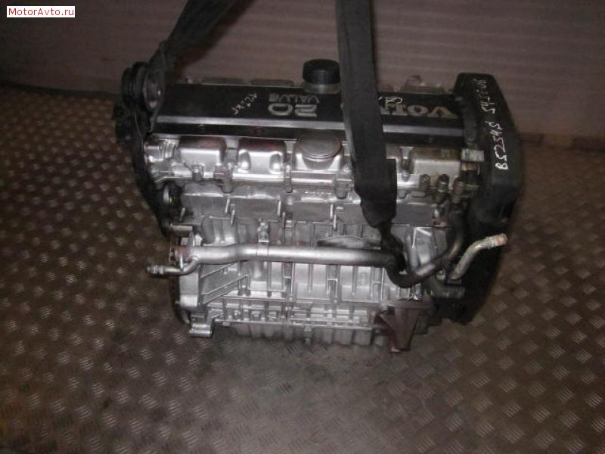
Cars usually have from 4 to 8 cylinders

Slide 13
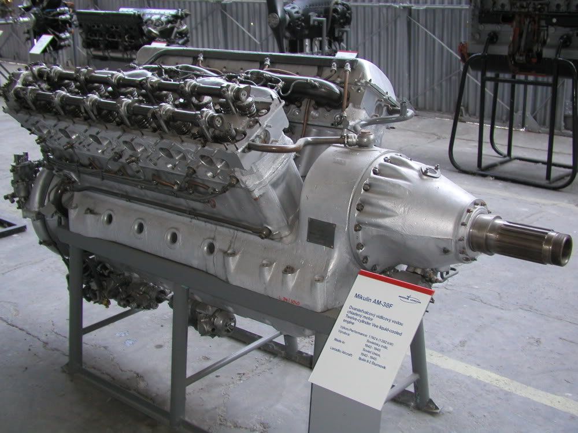
Large airplane engines may have 20. 24 or even 28 cylinders.

Slide 14
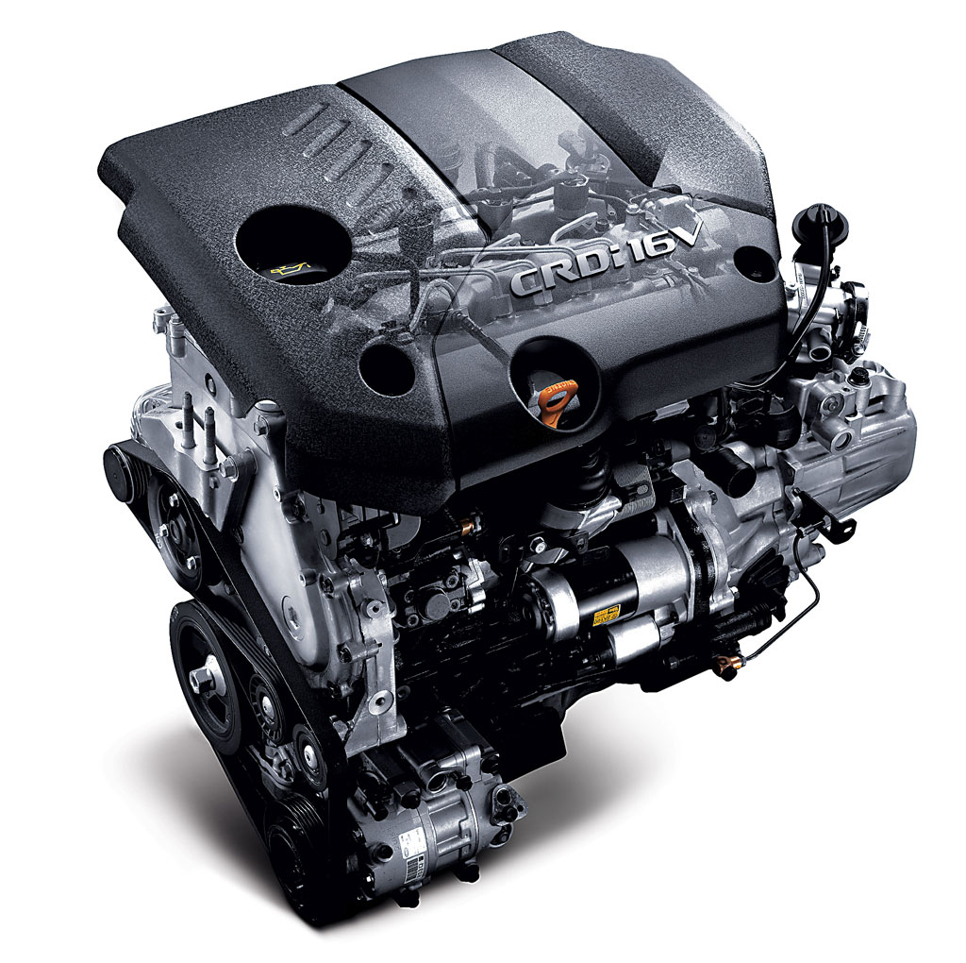
ENGINE
At present the internal combustion
engine plays an important role in
everyday life of transport system.
The engine is the heart of the car.
The engine is a source of power that
makes the wheels rotate and the
vehicle move.

Slide 15
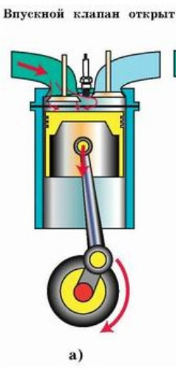
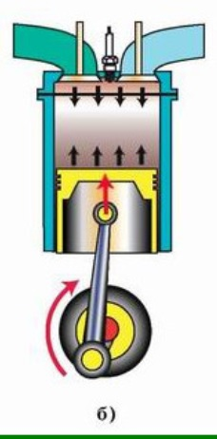
MAIN STROKES OF ENGINE WORK
The first stroke is called the inlet. The piston moves down the cylinder,
sucking in mixture of gases.
The second stroke is called compression. The valve shuts and in the next stroke the piston moves up, compressing the gases.

Slide 16
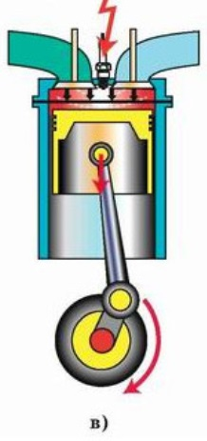
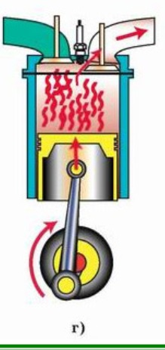
The third stroke is called the power stroke. The gases are heated
and they push the piston down. This is the stroke that really works ,
revolving the crankshaft.
The fourth stroke is called the exhaust. The piston moves up , pushing the used gases out through another valve.
Inside the cylinder the piston makes four movements : two down and two up. The crankshaft makes two full revolutions. This engine is called four- stroke cycle engine.

